Slide 1
Simple Threads
Business and Campaign Analysis

Slide 2
Agenda :
03
Project Overview
Data Cleaning
04
Quantitative Findings
05
Business Insights
06
13
14
Analysis Summary

Slide 3
Project Overview
Simple Threads, a boutique retail company that sells curated clothing online. The goal is to analyze the company's Q1 2025 business performance, customer behavior, and product sales trends. Additionally, the analysis will evaluate the effectiveness of an end-of-year discount email campaign to provide actionable insights for the management team.

Slide 4
Data Cleaning
Data cleaning was performed using a combination of Orange, Google Sheets and MySQL to ensure accuracy and consistency in Dataset. The steps are summarized below :
Cleaning Step | Description | Tool Used
Handling Missing Values. | Replacing missing amounts with median values. | Orange
Standardize Data Format | Correcting inconsistent Data formats. | Google Sheets
Correct Data Types | Change numerical fields from text to float. | Orange
Remove Duplicates | Identified and removed duplicate customer IDs and Product IDs. | MySQL

Slide 5
Quantitative Findings
Average spent per customer is 569.25 rupees
22 unique customers made purchase out of which 17 were in January and 5 were in february.
37 Discount codes were sent out of which 14 made purchases.
Total Sale revenue generated is 22,770 rupees.

Slide 6
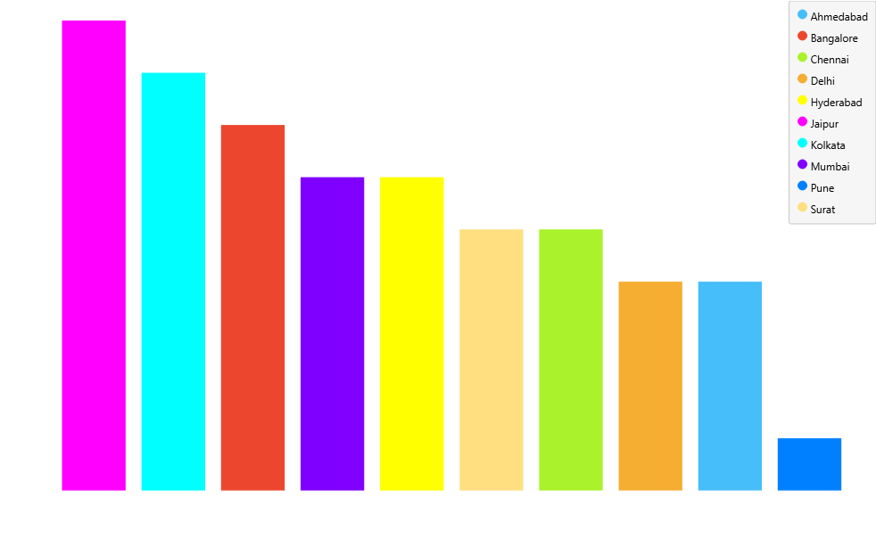
Distribution of customers across different regions
Jaipur is the primary customer hub, with a significantly larger customer base than all other cities combined.

Slide 7
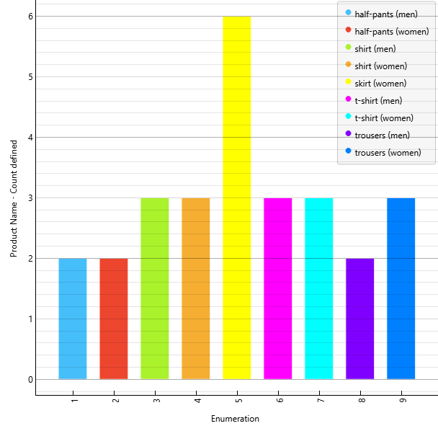
Product popularity
women's clothing, particularly skirts, t-shirts, and trousers, are most popular

Slide 8
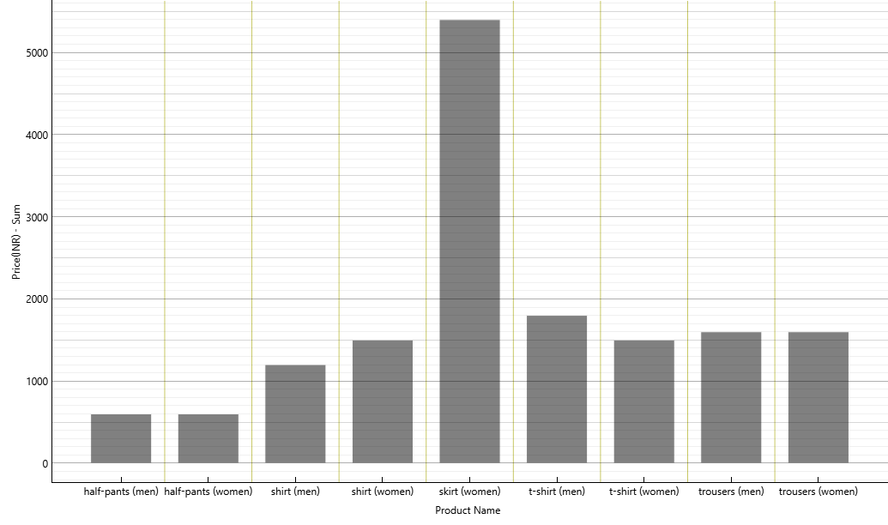
Sales trends across different product categories
skirts for women are the most lucrative product category, generating a significantly higher total sales value than any other item. In general, women's apparel consistently outperforms men's apparel in terms of revenue.

Slide 9
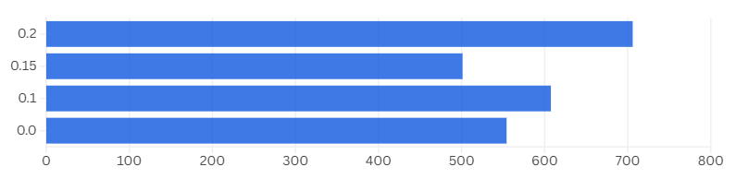
What Average Spend Suggests.
At first glance, the data tells us that offering a 20% discount encourages customers to spend the most on average. This makes it seem like our most powerful tool for driving high-value purchases.

Slide 10
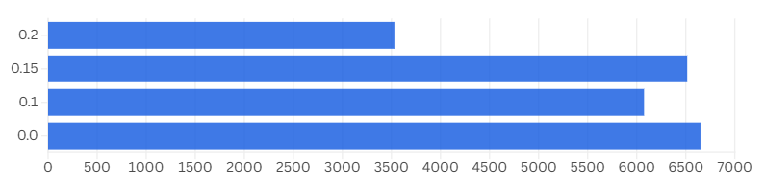
The Full Revenue Story
However, the picture changes completely when we look at total sales.
20% discount actually brought in the least money overall because it attracted very few buyers. Offering no discount or a 15% discount drove the highest revenue by attracting a much larger volume of customers.

Slide 11
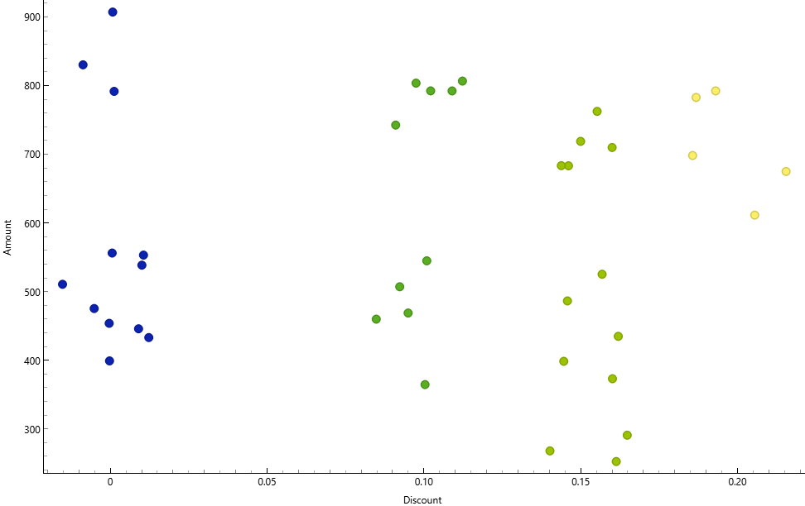
Connecting the Dots: A View of Customer Behavior
The 20% discount was a niche offer that only attracted a few big spenders. The real revenue came from the large crowd of customers brought in by the 0% and 15% discounts.This proves that our success comes from attracting a high volume of shoppers, not just a few high-value ones.

Slide 12
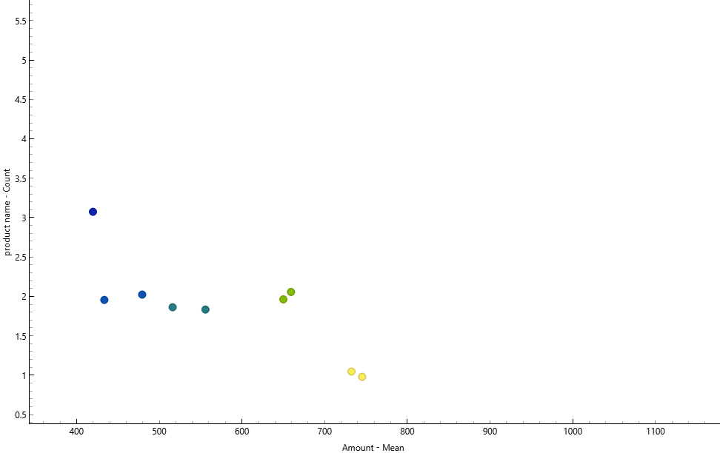
Business Insight Relationship between quantity purchased and product price
This suggests the market is highly price-sensitive. To drive sales volume, focusing on products in the lower-to-mid price range is the most effective strategy. The higher-priced items appear to be more niche or luxury purchases.

Slide 13
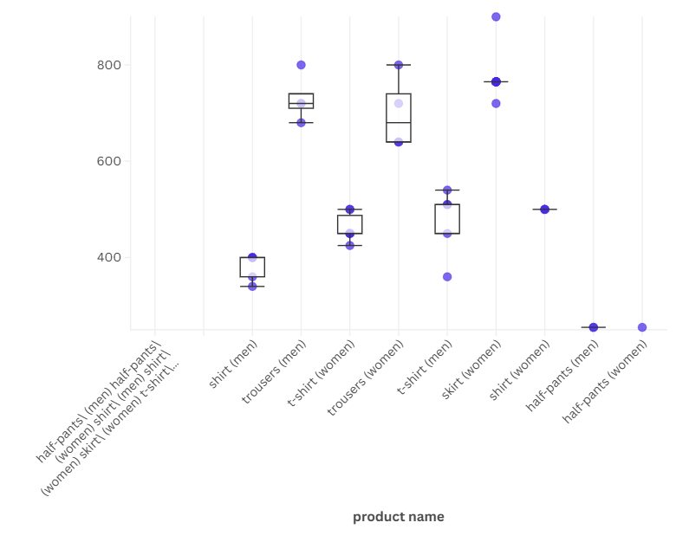
Pricing Strategy: A Deep Dive into Product Categories
Premium Opportunity in Women's Apparel Women's trousers command our highest average price and widest price range. This presents a clear opportunity to maximize high-margin sales by introducing a tiered product line, from standard to premium.

Slide 14
Analysis Summary
Focus on Volume: The market is highly price-sensitive, so the most profitable strategy is to attract more customers with 0% and 15% discounts, as these generate the highest total revenue.
Women's Apparel is Key: Women's clothing, especially skirts and trousers, drives the most sales and offers the best opportunity for high-margin pricing, with Jaipur being our primary market to target.

Slide 15
THANK
YOU

